Slide 1
System and Comms Diagram
Red LED
Green LED
0th Bit (least significant):
1 - Reverse Right Motor
0 - Forward Right Motor
2nd Bit:
1 - Reverse Left Motor
0 - Forward Left Motor
Pulse counter circuit
1st Bit:
1 - Right Motor on
0 - Right Motor off
3rd Bit:
1 - Left Motor on
0 - Left Motor off
IR Sensor
Power line
4th Bit:
1 – Goto grabbing sequence
0 – Continue as usual
Grabber Motor (R)
Wheel Motor (R)
Side sensor
A2
4
2
Motor instruction Byte: 000x xxxx
Arduino
Laptop
(python)
Phone Hotspot
Right sensor
A1
Current State
Left sensor
A0
3
1
Live video feed
(USB port)
Grabber Motor (L)
Wheel Motor (L)
State:
0 – Initial line following
1 – Nav to target
2 – Grab target
3 – Nav to T junction
4 – Line follow & dump
5 – Return to T junc through tunnel w/ line following
6 – Return to start pos.
7 – Do nothing (end)
Power line
Camera 3
Battery

Slide 2
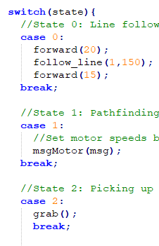
Code Structure
Update motor
Basic actions
Complex actions
Main Code
follow_line()
motor_L()
motor_R()
msg_motor()
rotate()
forward()
grab()
grabber_L()
grabber_R()
dump()
Arduino Flowchart
Python (Nav) Flowchart

Slide 3
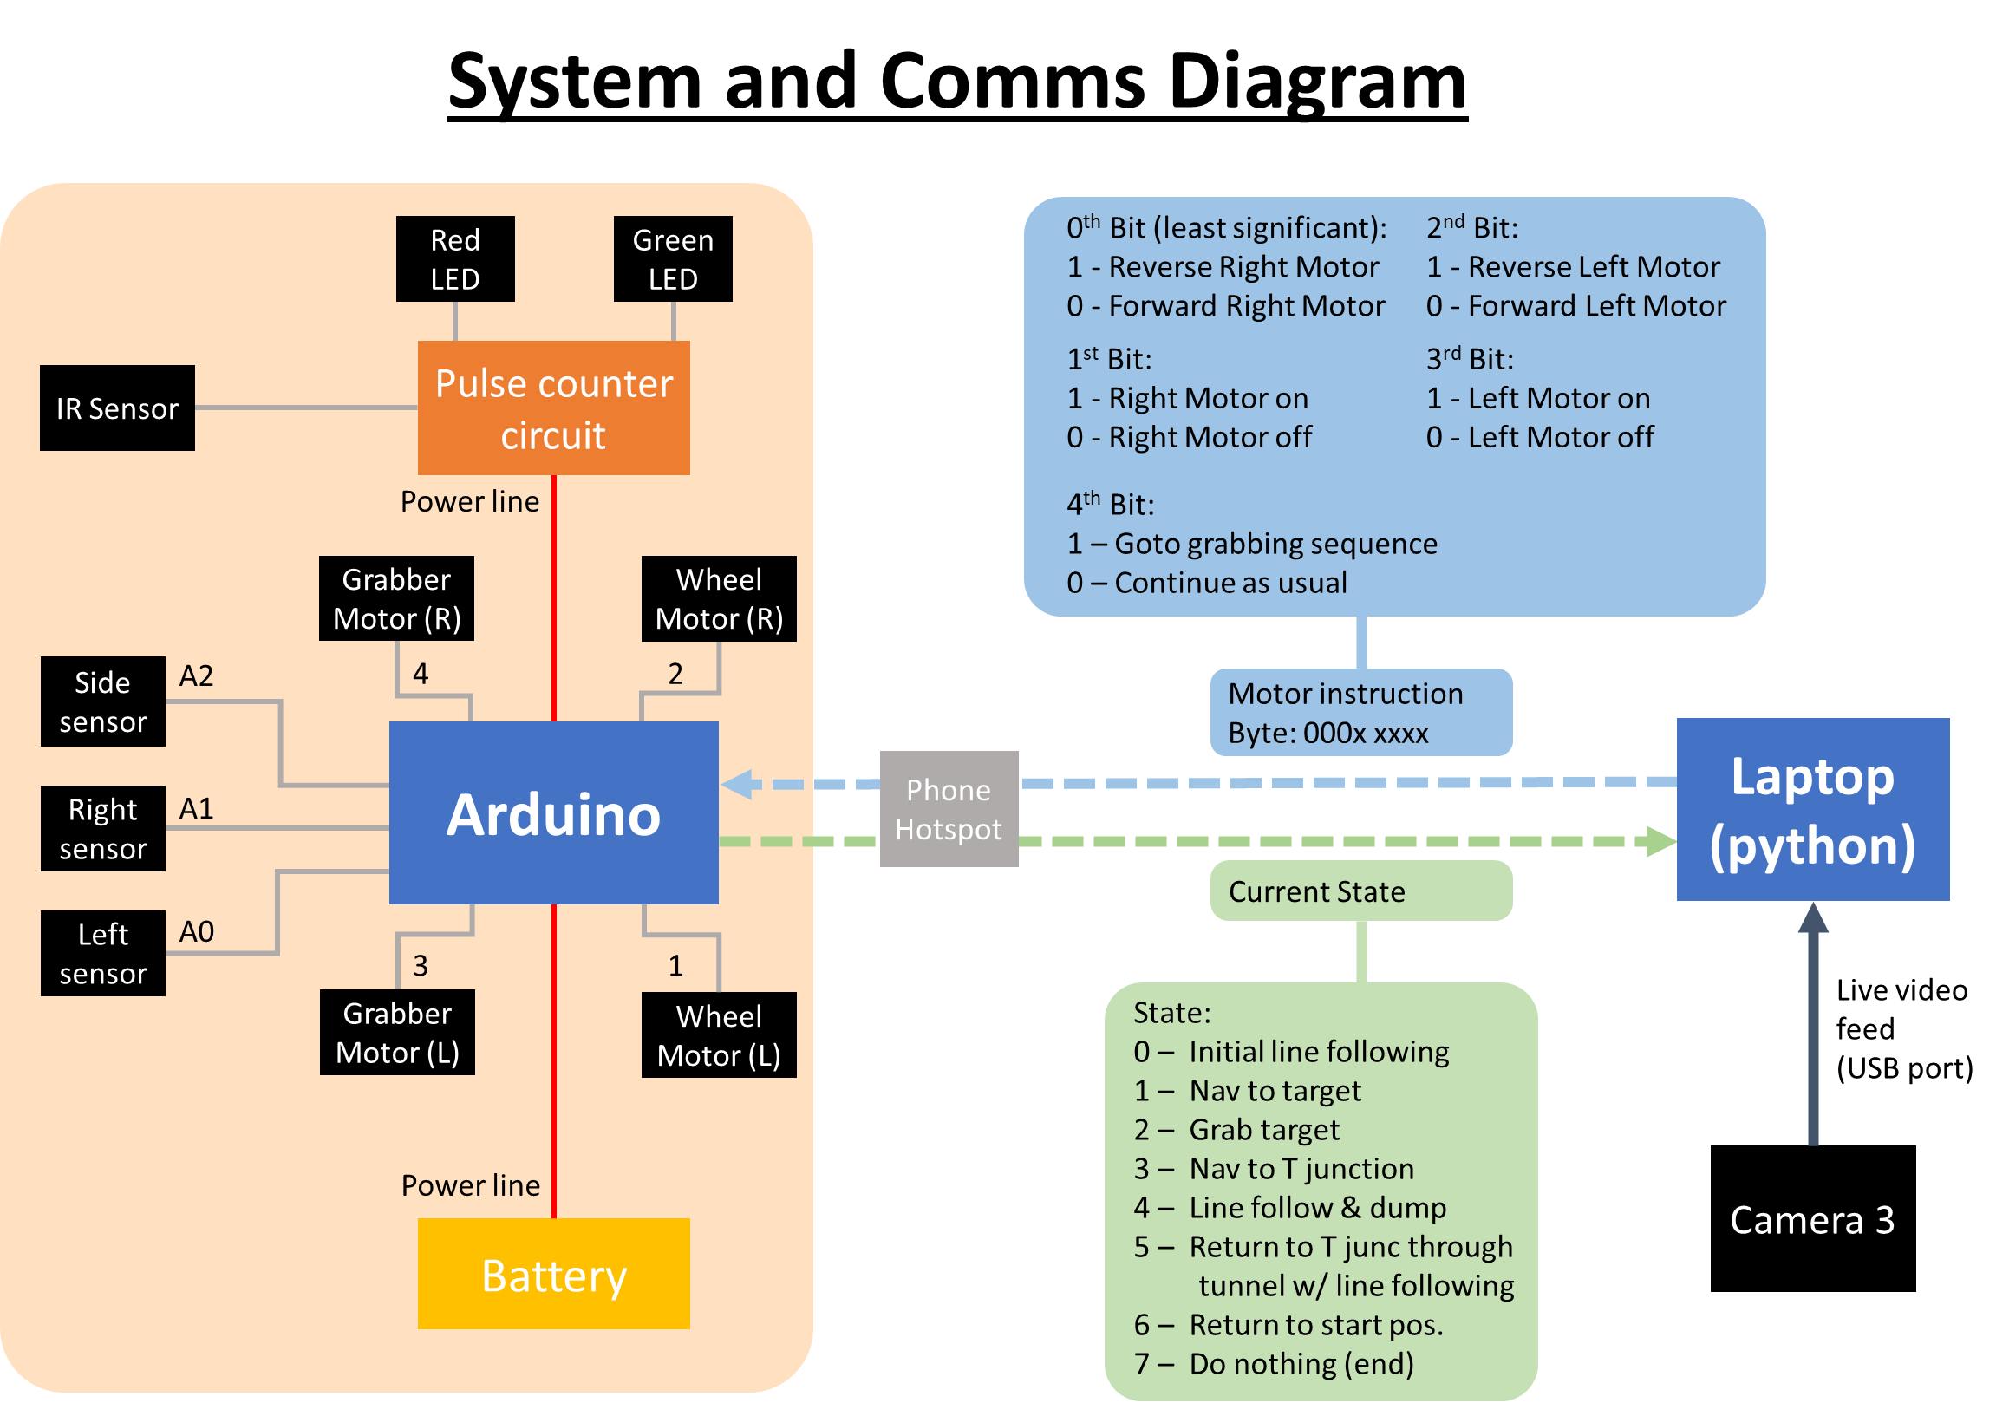

Slide 4
